Slide 1



Slide 2

Introduce the classical views
Compare and contrast image formation by computer with how images have been formed by architects, artists, and engineers
Learn the benefits and drawbacks of each type of view

Slide 3

Viewing requires three basic elements
  One or more objects
  A viewer with a projection surface
  Projectors that go from the object(s) to the projection surface
Classical views are based on the relationship among these elements
  The viewer picks up the object and orients it how she would like to see it
Each object is assumed to constructed from flat principal faces
  Buildings, polyhedra, manufactured objects

Slide 4

Standard projections project onto a plane
Projectors are lines that either
  converge at a center of projection
  are parallel
Such projections preserve lines
  but not necessarily angles
Nonplanar projections are needed for applications such as map construction

Slide 5

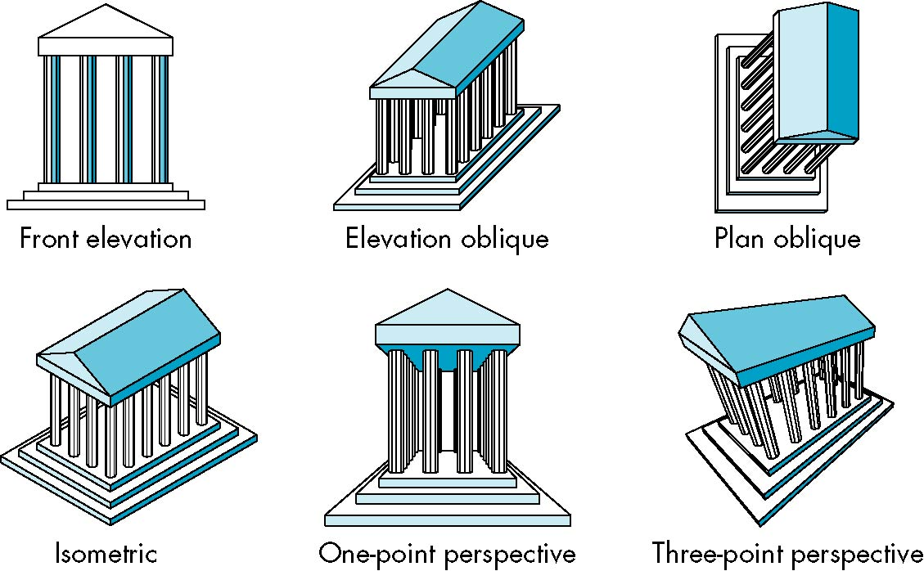

Slide 6

Computer graphics treats all projections the same and implements them with a single pipeline
Classical viewing developed different techniques for drawing each type of projection
Fundamental distinction is between parallel and perspective viewing even though mathematically parallel viewing is the limit of perspective viewing

Slide 7

planar geometric projections
parallel
perspective
1 point
2 point
3 point
multiview
orthographic
axonometric
oblique
isometric
dimetric
trimetric

Slide 8

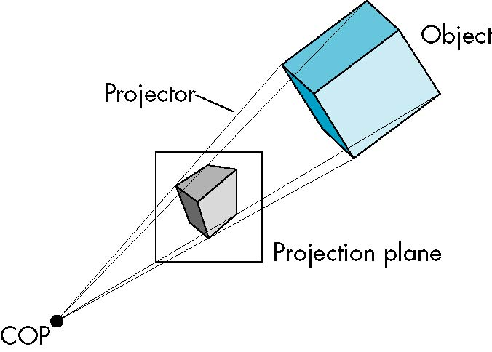

Slide 9

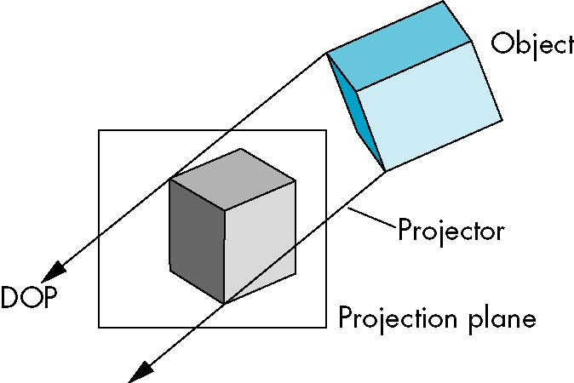

Slide 10

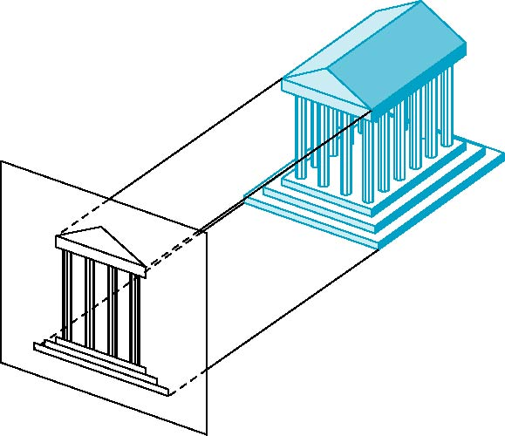
Projectors are orthogonal to projection surface

Slide 11


Projection plane parallel to principal face
Usually form front, top, side views
isometric (not multiview
orthographic view)
front
in CAD and architecture,
we often display three
multiviews plus isometric
side
top

Slide 12

Preserves both distances and angles
  Shapes preserved
  Can be used for measurements
    Building plans
    Manuals
Cannot see what object really looks like because many surfaces hidden from view
  Often we add the isometric

Slide 13

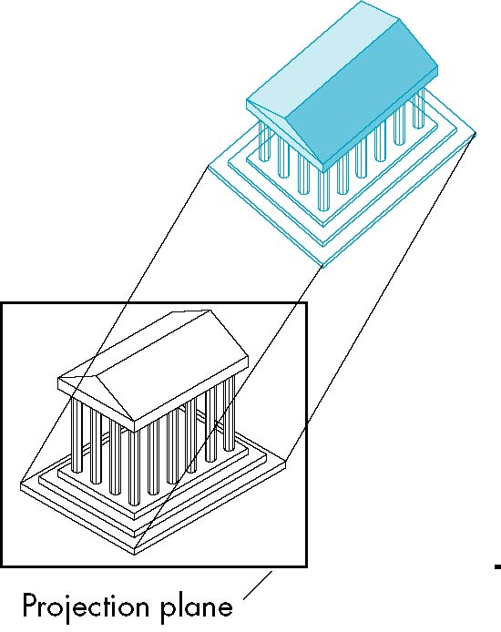
Allow projection plane to move relative to object
classify by how many angles of
a corner of a projected cube are
the same
none: trimetric
two: dimetric
three: isometric
θ ₁
θ ₂
θ ₃

Slide 14

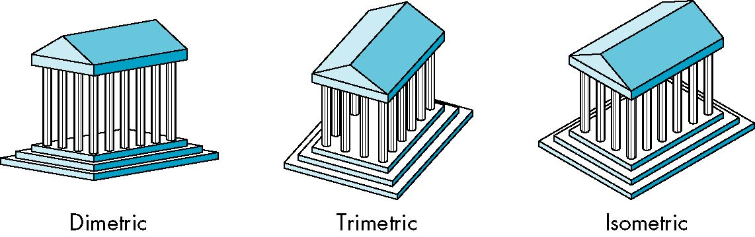

Slide 15
Lines are scaled (foreshortened) but can find scaling factors
Lines preserved but angles are not
  Projection of a circle in a plane not parallel to the projection plane is an ellipse
Can see three principal faces of a box-like object
Some optical illusions possible
  Parallel lines appear to diverge
Does not look real because far objects are scaled the same as near objects
Used in CAD applications

Slide 16

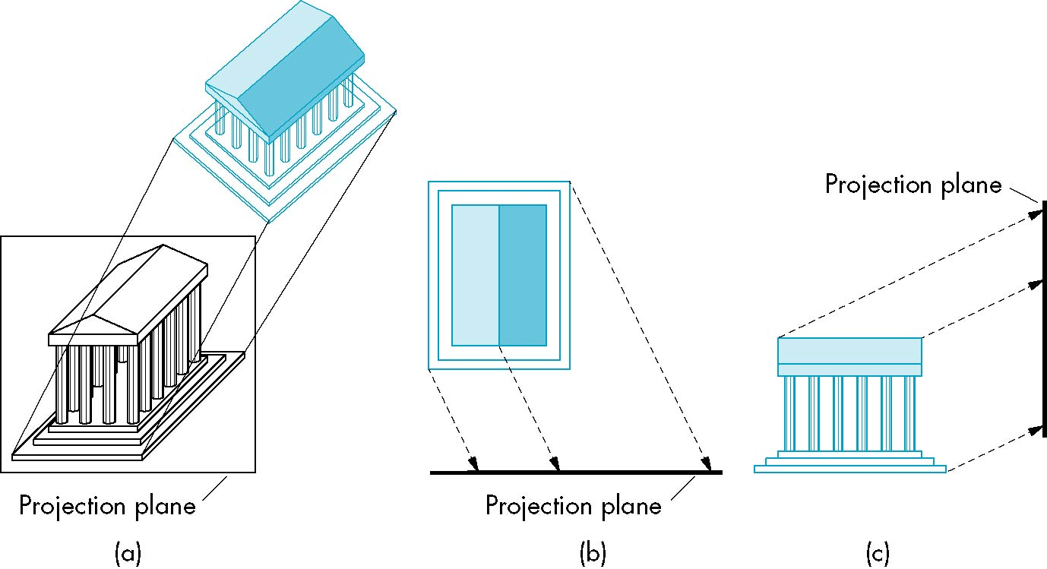
Arbitrary relationship between projectors and projection plane

Slide 17
Can pick the angles to emphasize a particular face
  Architecture: plan oblique, elevation oblique
Angles in faces parallel to projection plane are preserved while we can still see “around” side
In physical world, cannot create with simple camera; possible with bellows camera or special lens (architectural)

Slide 18
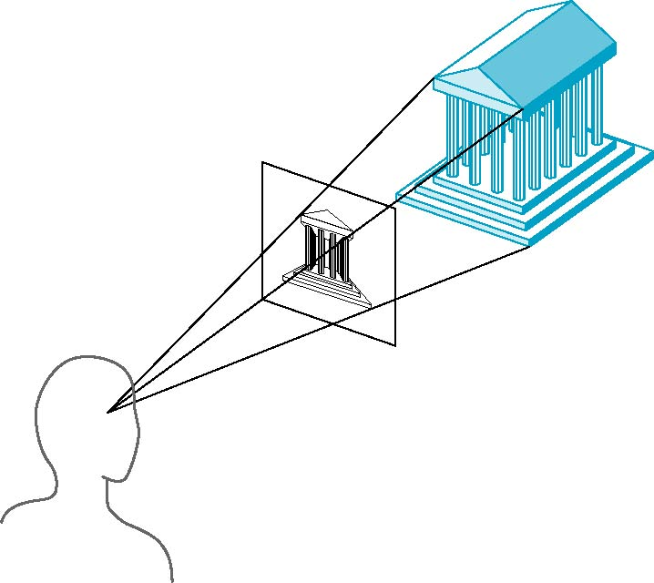
Projectors coverge at center of projection

Slide 19

Parallel lines (not parallel to the projection plan) on the object converge at a single point in the projection (the vanishing point)
Drawing simple perspectives by hand uses these vanishing point(s)
vanishing point

Slide 20

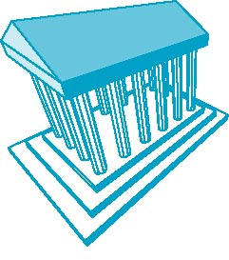
No principal face parallel to projection plane
Three vanishing points for cube

Slide 21

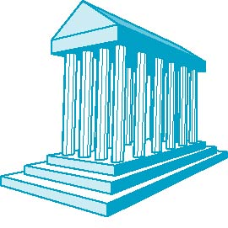
On principal direction parallel to projection plane
Two vanishing points for cube

Slide 22

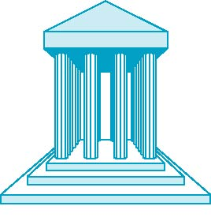
One principal face parallel to projection plane
One vanishing point for cube

Slide 23
Objects further from viewer are projected smaller than the same sized objects closer to the viewer (diminution)
  Looks realistic
Equal distances along a line are not projected into equal distances (nonuniform foreshortening)
Angles preserved only in planes parallel to the projection plane
More difficult to construct by hand than parallel projections (but not more difficult by computer)

